Slide 1

Used Car Price Prediction
sundataai@gmail.com
YTDZAIRBPM
This file is meant for personal use by sundataai@gmail.com only.

Slide 2
Contents / Agenda
Executive Summary
Business Problem Overview
Solution Approach
Data Overview
^{sund}●^{ataai@}ED^{gm}A^{ai}-^{l.c}U^{om}nivariate Analysis
YTDZAIRBPM
Univariate Analysis - Key Ǫuestions
EDA - Multivariate Analysis
Multivariate Analysis - Key Ǫuestions
This file is meant for personal use by sundataai@gmail.com only.

Slide 3
Business Context
There is a huge demand for used cars in the Indian Market today. As sales of new cars have slowed down in the recent past, the pre-owned car market has continued to grow over the past years and is larger than the new car market now. Cars4U is a budding tech start-up that aims to find food holes in this market.
In 2018-19, while new car sales were recorded at 3.6 million units, around 4 million second-hand cars were bought and sold. There is a slowdown in new car sales and that could mean that the demand is shifting towards the pre-owned market. In fact, some car sellers replace their old cars with pre-owned cars instead of buying new ones.
Unlike new cars, where price and supply are fairly deterministic and managed by OEMs (Original Equipment Manufacturer / except for dealership level discounts which come into play only in the last stage of the customer journey), used cars are very different beasts with huge uncertainty in both pricing and supply. Keeping this in mind, the pricing scheme of these used cars becomes important in order to grow in the market.
As a senior data scientist at Cars4U, you have to come up with a pricing model that can effectively predict the price of used cars and can help the business in devising profitable strategies using differential pricing. For example, if the business knows the market price, it will never sell anything below it.
persons.
This file is meant for personal use by sundataai@gmail.com only.

Slide 4
Business Objective
Data Description
To explore and visualize the dataset, build a linear regression model to predict the prices of used cars, and generate a set of insights and recommendations that will help the business.
The data contains the different attributes of used cars sold in different locations. The detailed data dictionary is given below.
Brand: brand name of the car
Model Name: model name of the car
Location: Location in which the car is being sold or is available for purchase (cities)
Year: Manufacturing year of the car
Kilometers_driven: The total kilometers driven in the car by the previous owner(s) in km
Fuel_Type: The type of fuel used by the car (Petrol, Diesel, Electric, CNG, LPG)
Transmission: The type of transmission used by the car (Automatic/Manual)
Owner_Type: Type of ownership
Mileage: The standard mileage offered by the car company in kmpl or km/kg
Engine: The displacement volume of the engine in CC
Power: The maximum power of the engine in bhp
Seats: The number of seats in the car
New_Price: The price of a new car of the same model in INR Lakhs (1 Lakh = 100,000 INR)
Price: The price of the used car in INR Lakhs
sundataai@gmail.com
This file is meant for personal use by sundataai@gmail.com only.

Slide 5
Solution Approach
Understand the demand of restaurants in the FoodHub portal
Cuisine preference of the New York customers
Get an idea about the cost of the ordered food
Understand the volume of the orders over weekdays and weekends
^{sund}●^{ataai@}Es^{g}t^{m}im^{ail}a^{.c}tºe^{m}the revenue generated by the company
YTDZAIRBPM
Help the company to take decision on promotional offers
Order rating analysis
This file is meant for personal use by sundataai@gmail.com only.

Slide 6
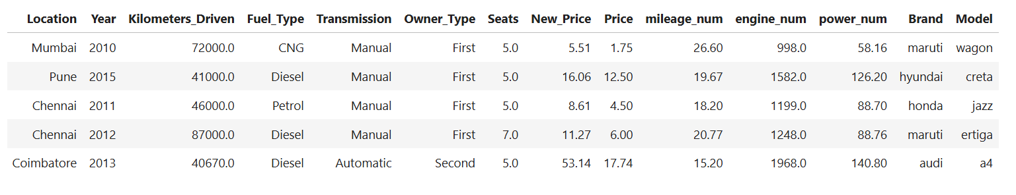
Data Overview
The above table demonstrate a partial section of the given data set. The data set is illustrated on the top five rows of the data set.
This file is meant for personal use by sundataai@gLminakil.ctoomAponpley.ndix slide on data background check

Slide 7
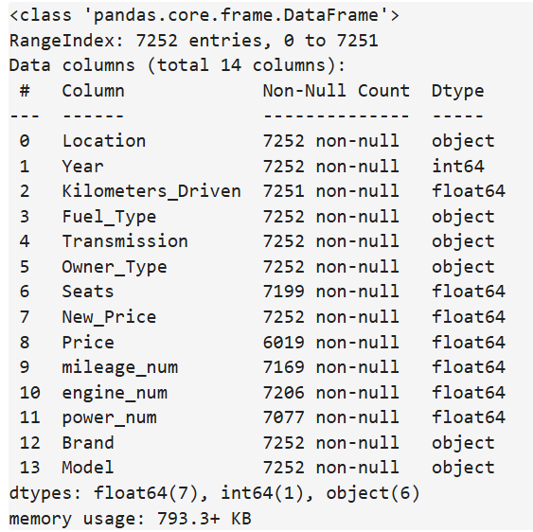
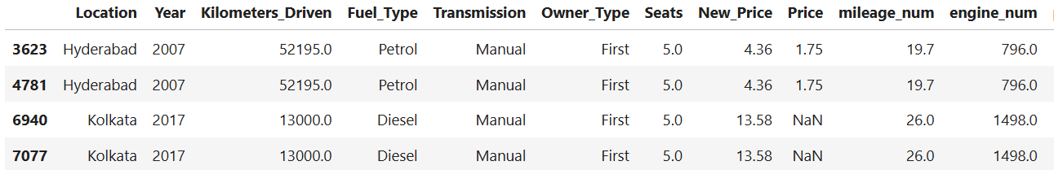
Univariate Analysis
There are two duplicate value in the data.
Let's take a closer look at it. There is a good chance that two cars of the same build were sold in the same location.
But it is highly unlikely that both of them will have the same number of kilometers driven.
So, we will drop the row which occurs second.
There is a good chance that two cars of the same build were sold in the same location.
But it is highly unlikely that both of them will have the same number of kilometers driven.
So, we will drop the row which occurs second.
6 columns are of the object type columns and 7 columns are of numerical type columns
This file is meant for personal use by sundataai@gmail.com only.

Slide 8
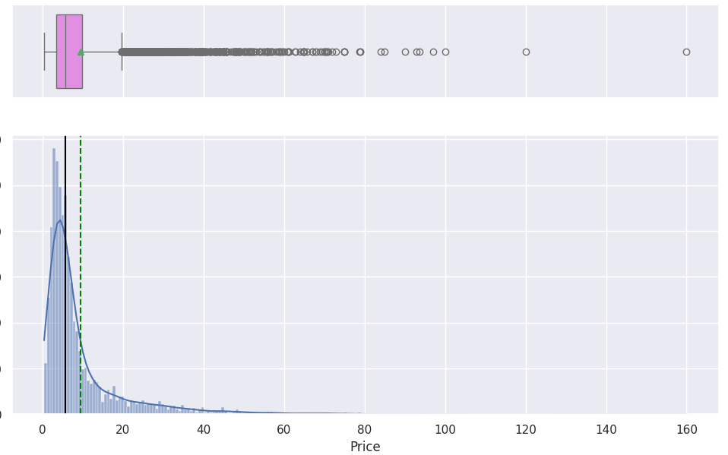
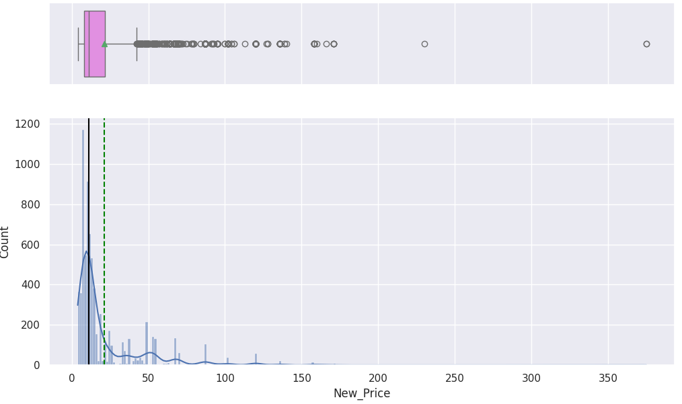
Univariate Analysis
sundataai@gmail.com YTDZAIRBPM
This is a highly skewed distribution.
This file is meant for personal use by sundataai@gmail.com only.

Slide 9
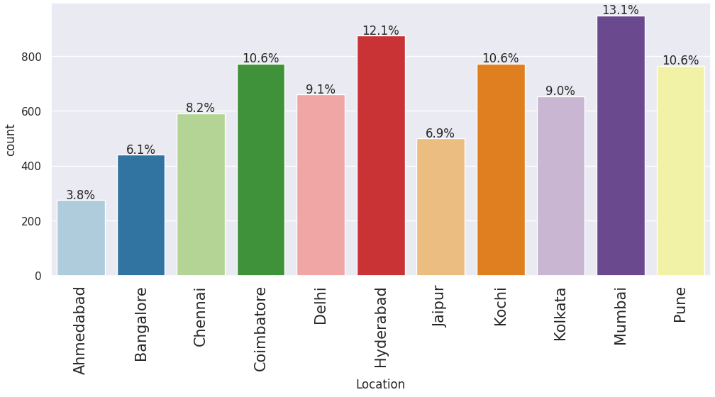
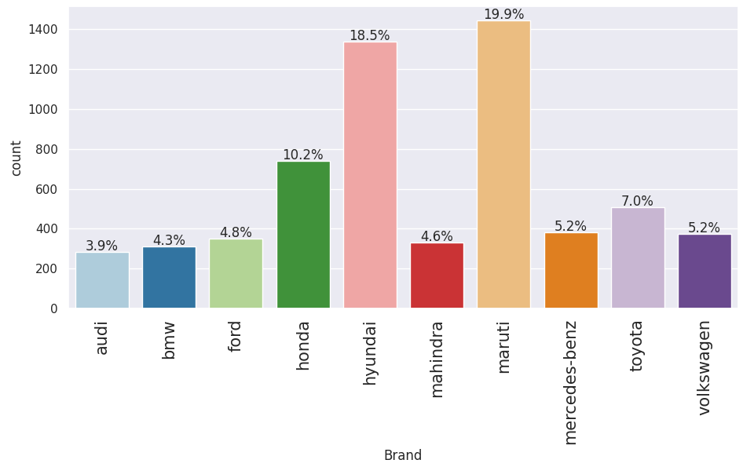
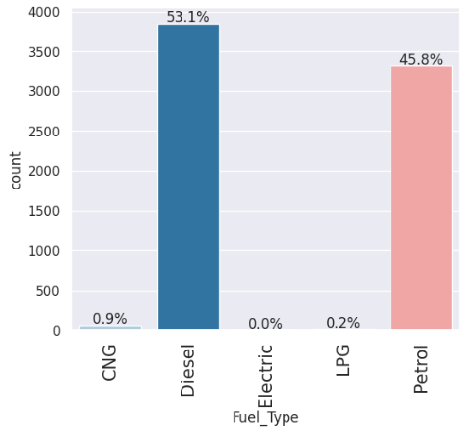
Univariate Analysis
sundataai@gmail.com YTDZAIRBPM
Around 1% of the cars in the dataset do not run on diesel or petrol.
Hyderabad and Mumbai have the most demand for used cars. The price of used cars has a large IQR in Coimbatore and Bangalore.
Most of the cars in the data belong to Maruti or Hyundai. The price of used cars is lower for budget brands like Porsche, Bentley, Lamborghini, etc. The price of used cars is higher for premium brands like Maruti, Tata, Fiat, etc.
This file is meant for personal use by sundataai@gmail.com only.

Slide 10
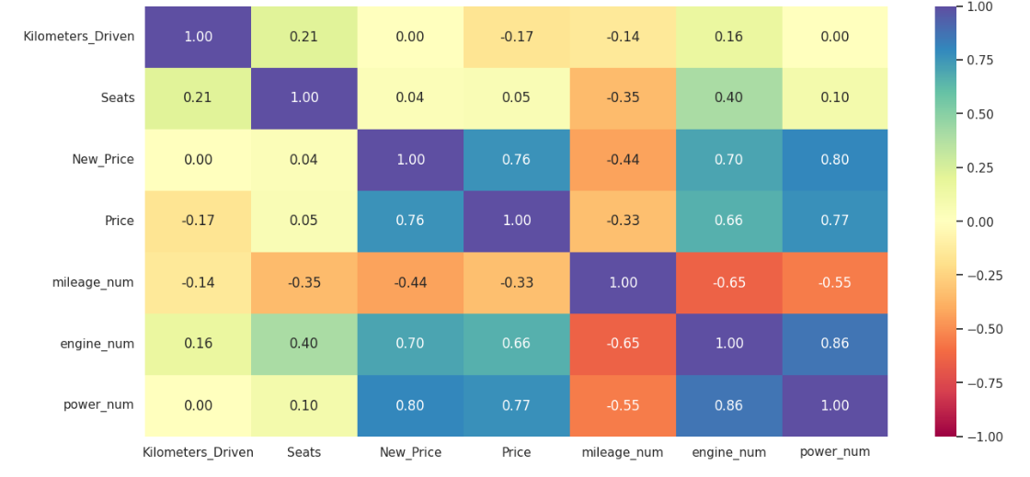
Analysis
sundataai@gmail.com YTDZAIRBPM
This file is meant for personal use by sundataai@gmail.com only.

Slide 11
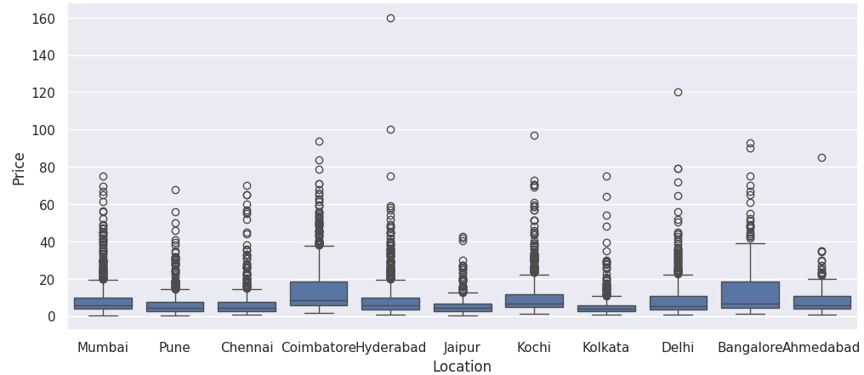
Bi-variate Analysis
sundataai@gmail.com YTDZAIRBPM
This file is meant for personal use by sundataai@gmail.com only.

Slide 12
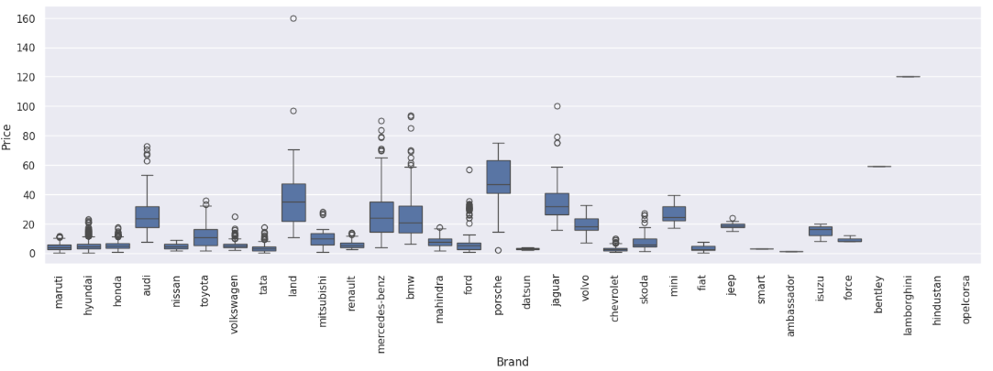
Bi-variate Analysis
YTDZAIRBPM
This file is meant for personal use by sundataai@gLminakil.ctoomAponpley.ndix slide on data background check

Slide 13
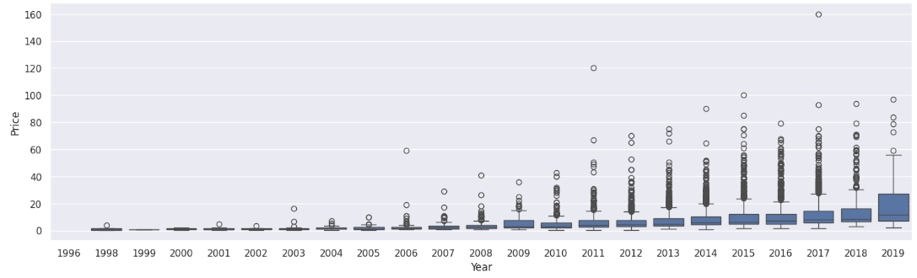
Bivariate Analysis
sundataai@gmail.com YTDZAIRBPM

Slide 14
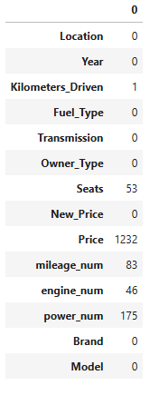
Missing value treatment
We will use a similar method to fill missing values for the Kilometers_Driven, mileage_num, engine_num, and power_num columns.
We'll impute these missing values one-by-one by taking the median number of seats for the particular car using the Brand and Model.
There are still some missing values in mileage_num and power_num.
We'll impute these missing values by taking the median grouped by the Brand.
Missing values in all columns except Price are imputed.
We will drop the rows where Price is missing as it is the target variable. All missing values are dealt with.
This file is meant for personal use by sundataai@gmail.com only.

Slide 15
Model Building - Linear Regression
We want to predict the used car price.
Before we proceed to build a model, we'll have to encode categorical features.
We'll split the data into train and test to be able to evaluate the model that we build on the train data.
We will build a Linear Regression model using the train data and then check it's performance.
sundataai@gmail.com YTDZAIRBPM
This file is meant for personal use by sundataai@gmail.com only.

Slide 16
Model Performance Check
The dataset X has 264 columns and 6018 rows
Number of rows in train data = 4212
Number of rows in test data = 1806
Root Mean Squared Error (RMSE) and Mean Absolute Error (MAE) of train and test data are close, which indicates that our model is not overfitting the train data.
MAE indicates that our current model is able to predict used car prices within a mean error of 4.3 lakhs on test data.
The units of both RMSE and MAE are the same, Lakhs in this case. But RMSE is greater than MAE because it penalizes the outliers more
sundataai@gmail.com
This file is meant for personal use by sundataai@gmail.com only.

Slide 17
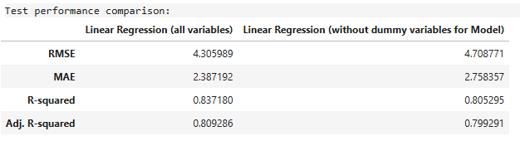
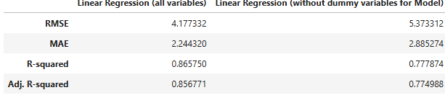
Model Building - Linear Regression without dummy variables for Model
Both the R-squared and Adjusted R squared of our model are lesser than before and the model is able to explain up to 80% of the variance in the price of used cars.
MAE indicates that our current model is able to predict used car prices within a mean error of 2.75 lakhs on test data.
sundataai@gmail.com
This file is meant for personal use by sundataai@gmail.com only.

Slide 18
Business Insights and Recommendations
Our linear regression model has successfully explained approximately 83% of the variation in the data.
The Mean Absolute Error (MAE) indicates that our current model can predict used car prices with an average error of around 2.38 lakhs on the test data.
Our analysis has revealed that certain factors, such as the year of manufacture, the number of seats, and the maximum power of the engine, tend to increase the price of a used car. Conversely, factors like the distance traveled and engine volume tend to decrease the price of a used car.
Certain markets tend to have higher prices, and it would be beneficial for Cars4U to focus on these markets and establish offices in these areas if necessary.
We need to gather data on the cost side of things before discussing profitability in the business.
After analyzing the data, the next step would be to cluster the different data sets and determine whether we should create multiple models for different locations or car types.
sundataai@gmail.com
This file is meant for personal use by sundataai@gmail.com only.

Slide 19
Appendix: Detailed Exploratory Data Analysis (EDA)
Price: The price of a used car is the target variable and has a highly skewed distribution, with a median value of around 53.5 lakh INR. The log transformation was applied on this column to reduce skewness. The displacement volume of the engine, the maximum power of the engine and the price of a new car of the same model is highly correlated with the price of a used car.
Mileage: This attribute has a close to normally distribution. With increase in mileage, the engine displacement and power decrease.
Engine: There are a few upper outliers, indicating that there are a few car with a higher engine displacement volume. Higher priced cars have higher engine displacement. It is also highly correlated with the maximum engine power.
Power: There are a few upper outliers, indicating that there are a few car with a higher power. Higher priced cars have higher maximum power. It is also highly correlated with the engine displacement volume.
Kilometers_driven: The number of kilometers a used car is driven has a highly skewed distribution, with a median value of around 53.5 thousand. The log transformation was applied on this column to reduce skewness.
sundataai@gmail.com
This file is meant for personal use by sundataai@gmail.com only.

Slide 20
Appendix: Detailed Exploratory Data Analysis (EDA)
New_Price: The price of a used car is the target variable and has a highly skewed distribution, with a median value of around 11.3 lakh INR. The log transformation was applied on this column to reduce skewness.
Seats: 84% of the cars in the dataset are 5-seater cars.
Year: More than half the cars in the data were manufactured in or after 2014. The price of used cars has increased over the years.
Brand: Most of the cars in the data belong to Maruti or Hyundai. The price of used cars is lower for budget brands like Porsche, Bentley, Lamborghini, etc. The price of used cars is higher for premium brands like Maruti, Tata, Fiat, etc.
Model: Maruti Swift is the most common car up for resale. The dataset contains used cars from luxury as well as budget-friendly brands.
Location: Hyderabad and Mumbai have the most demand for used cars. The price of used cars has a large IQR in Coimbatore and Bangalore.
Fuel_Type: Around 1% of the cars in the dataset do not run on diesel or petrol. Electric cars have the highest median price, followed by diesel cars.
Transmission: More than 70% of the cars have manual transmission. The price is higher for used cars with automatic transmission.
Owner_Type: More than 80% of the used cars are being sold for the first time. The price of cars decreases as they keep getting resold.
sundataai@gmail.com
This file is meant for personal use by sundataai@gmail.com only.

